Slide 1
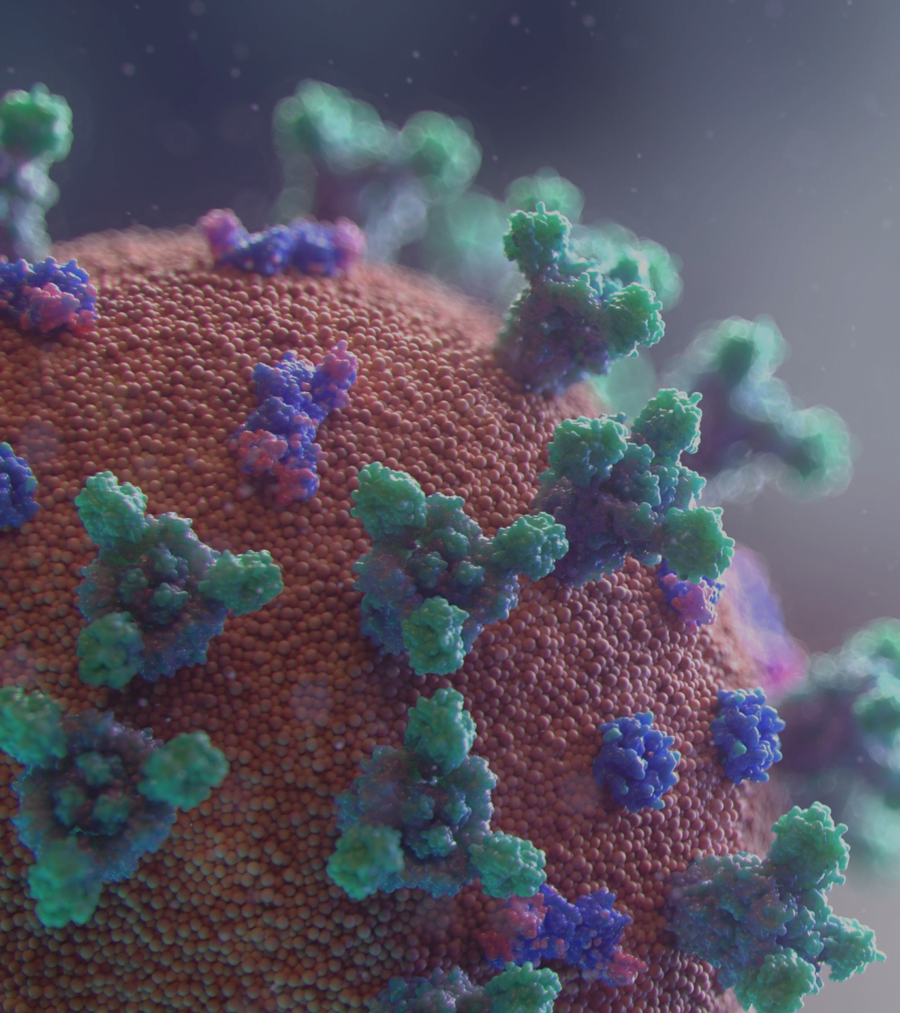

COVID-19 FORECASTING & X-RAY IMAGE DETECTION

Slide 2


CONTRIBUTORS
Jay Patel
Faizal Kazi
Pradeep Tomar
Akash Sharma
Aleena Almeida

Slide 3
COVID-19 STATS
CONFIRMED CASES
CONFIRMED CASES
India - 44,768,172
Globally - 6,85,886,700
Total Vaccinations
Total Vaccinations
Population vaccinated – 95%
Population vaccinated – 81%
95%
81%

Slide 4
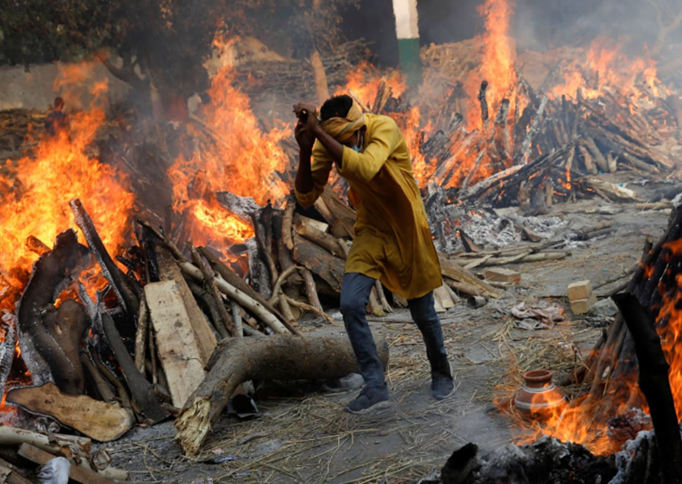

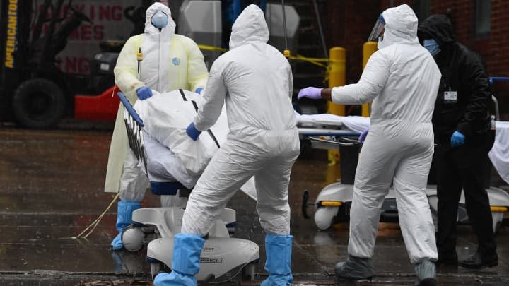
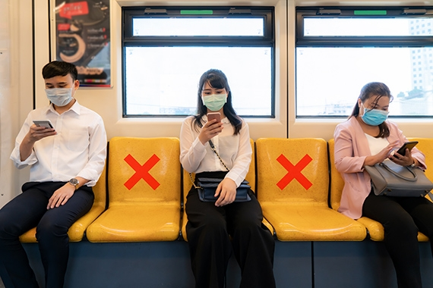
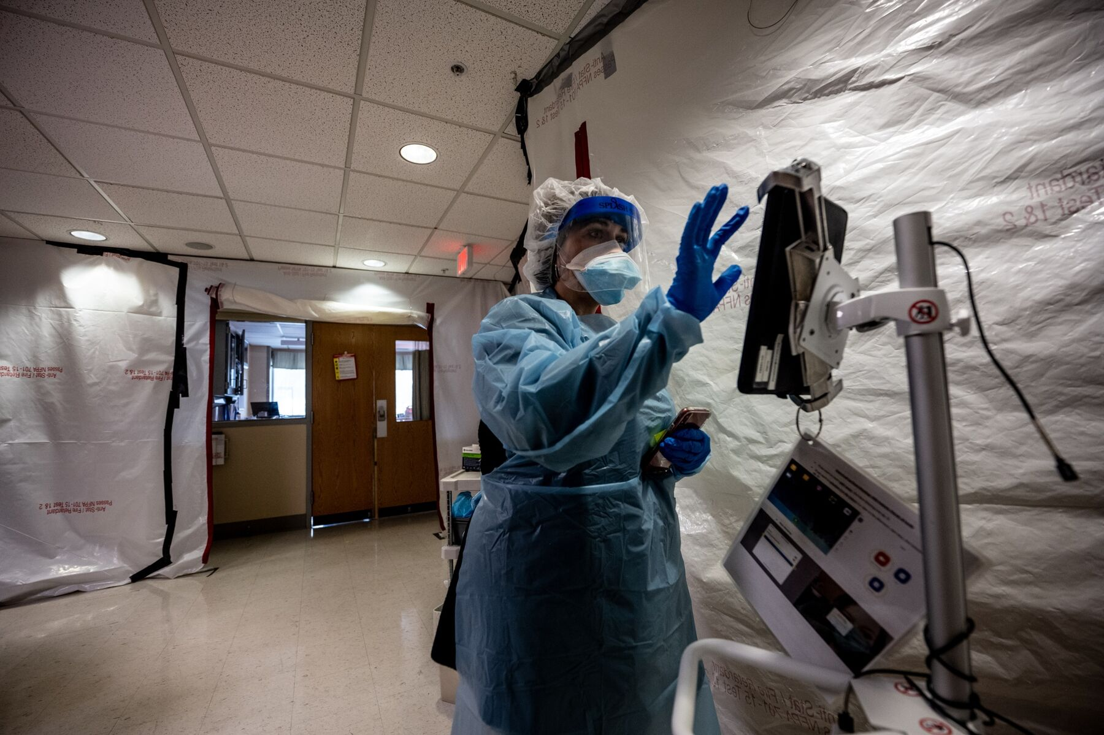
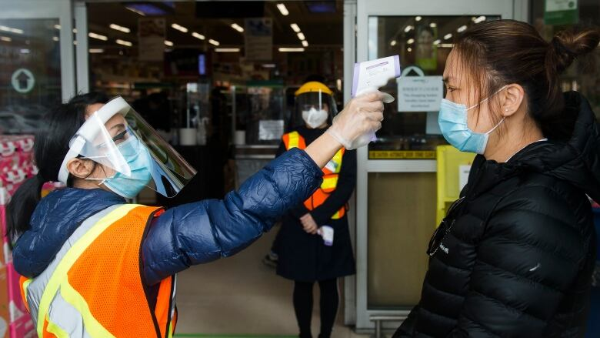
THE UNFORGETTABLE PAST...
1
2
3
4
5

Slide 5
1
2
3
4
5

Slide 6
1
2
3
4
5

Slide 7
1
2
3
4
5

Slide 8
1
2
3
4
5

Slide 9
1
2
3
4
5

Slide 10
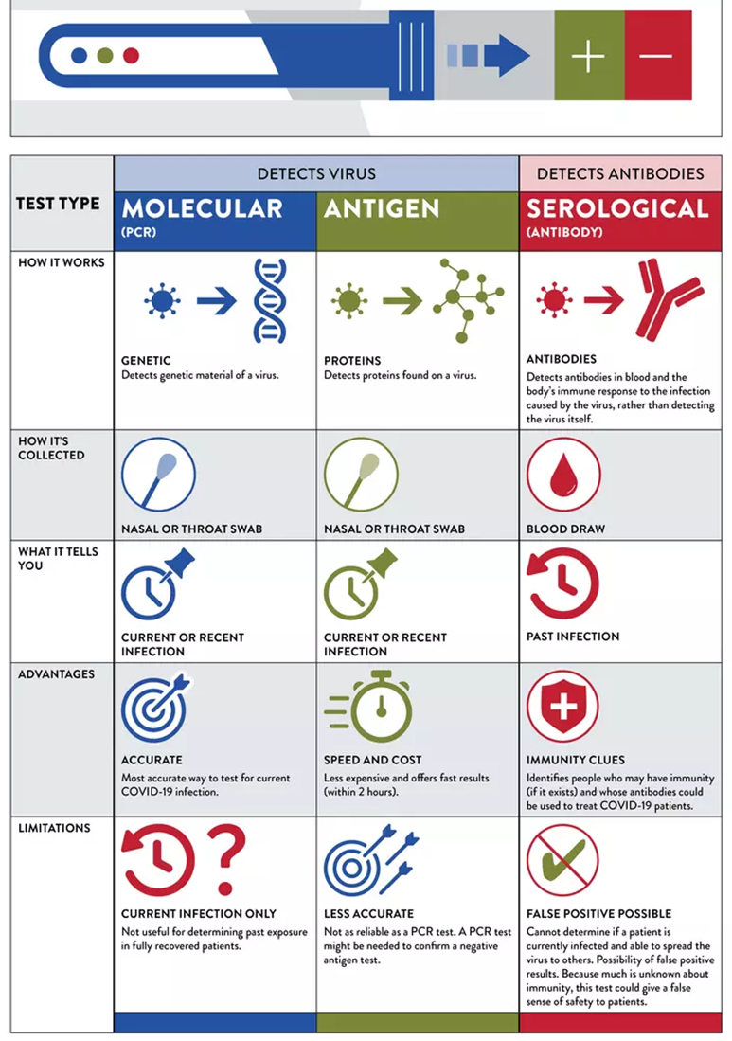


COVID-19 DETECTION METHODS

Slide 11

CONTENT
1.
PROBLEM STATEMENT
2.
ANALYTICAL GOALS
3.
METHODS OF ANALYSIS
4.
DATASET
5.
EXPLORATORY DATA ANALYSIS
6.
RESULTS
7.
FUTURE SCOPE

Slide 12

PROBLEM STATEMENT
Problems
Solutions
Time consuming
RT-PCR takes 24 hours
Antigen is fast, but not reliable
Expensive
Nose & throat swabs are expensive
Testing kits are cheap, but not 100% reliable
Low reliability
To save time/money, reliability is risked.
The virus still exists & there’s no apt solution.
Model to forecast Covid cases
This model will help to analyse covid cases according to region
Prediction model
The model will determine covid or not with the help of X-Ray images
Valuable insights
Insights will help take proactive measures & control the spread of the disease

Slide 13

ANALYTICAL GOALS
Build
An analytical model that can forecast and reliably categorize these photos into COVID or NORMAL categories, and potentially help in the prediction of Covid-19
Achieve
Achieve high accuracy to classify images into two categories (COVID & NORMAL) using CNN model.
Evaluate
Evaluate various metrics like accuracy, recall, and F1 score to better understand the classifier's performance.

Slide 14

METHODS OF ANALYSIS
Forecasting & X-Ray Image Detection

Slide 15
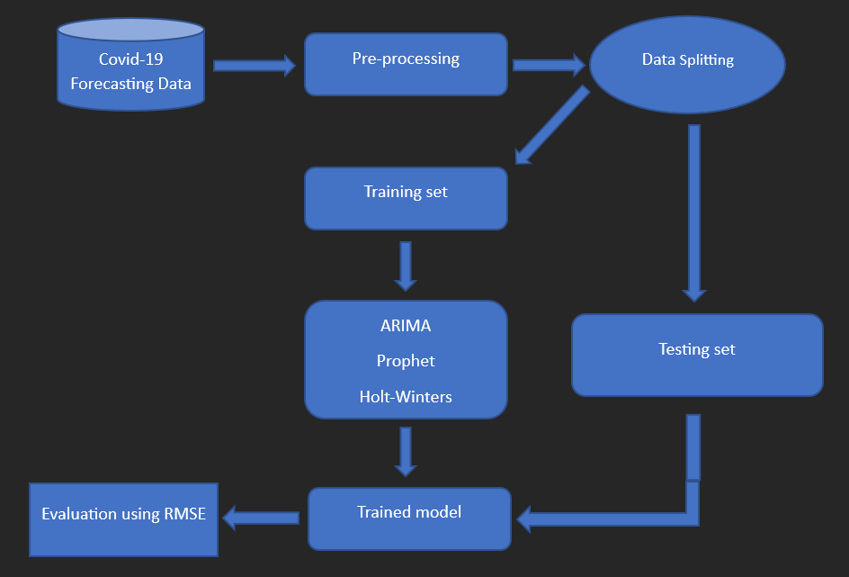
Covid-19 Forecasting

Slide 16
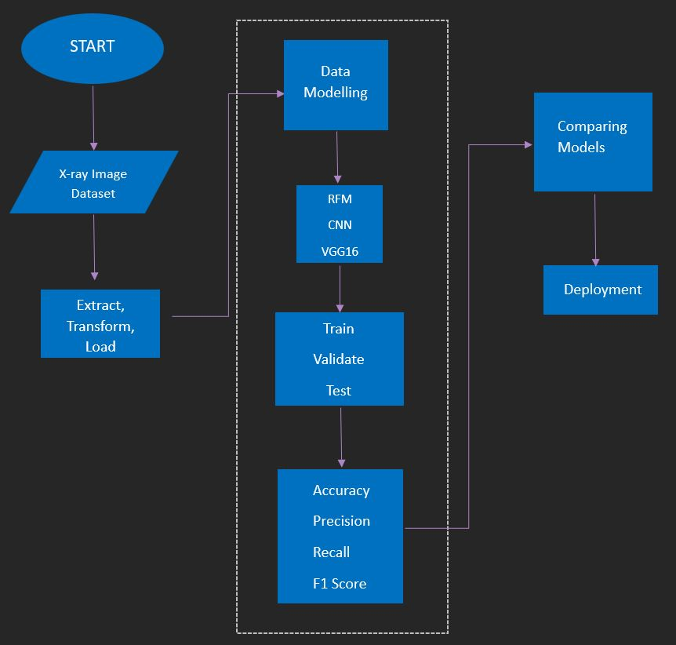
X-Ray Image Detection

Slide 17
Data source – Kaggle
Forecasting data
X-Ray data
DATASET

Slide 18
EXPLORATORY DATA ANALYSIS
Covid-19 Forecasting

Slide 19
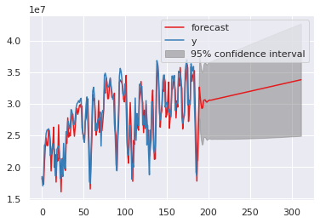
ARIMA model

Slide 20
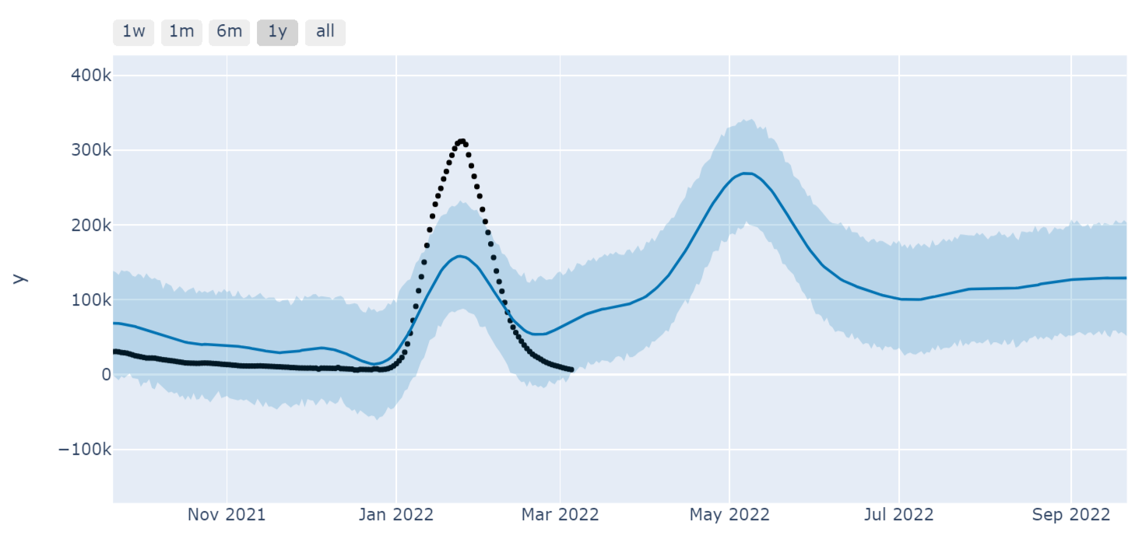
FB Prophet model

Slide 21
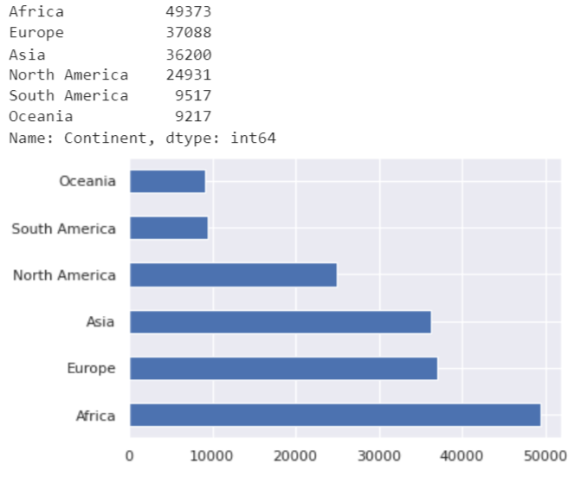
Covid cases by Continent

Slide 22
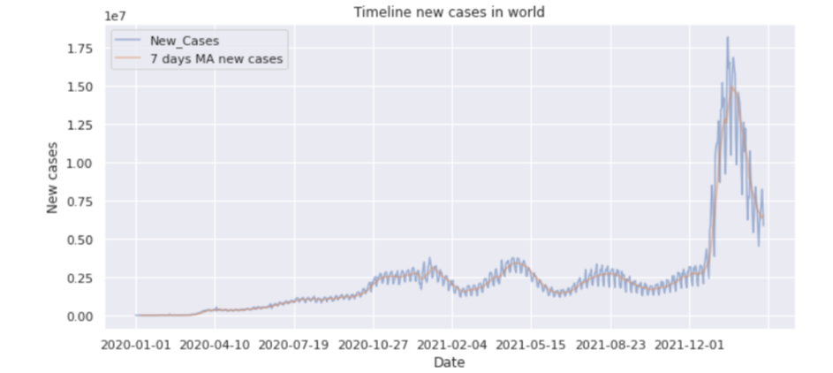

Slide 23
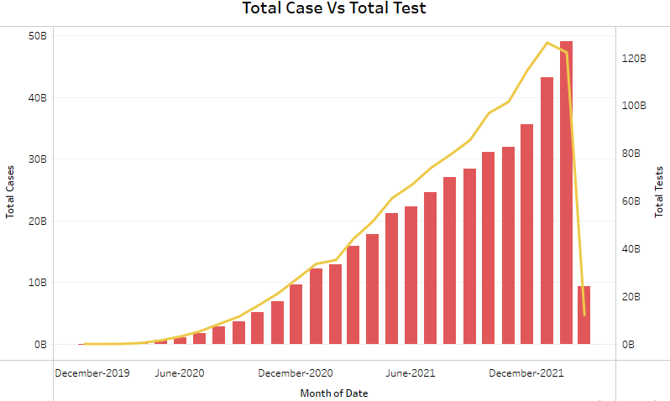

Slide 24
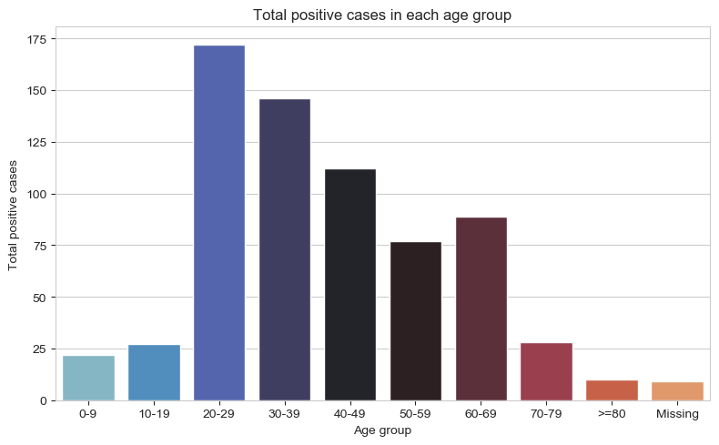

Slide 25
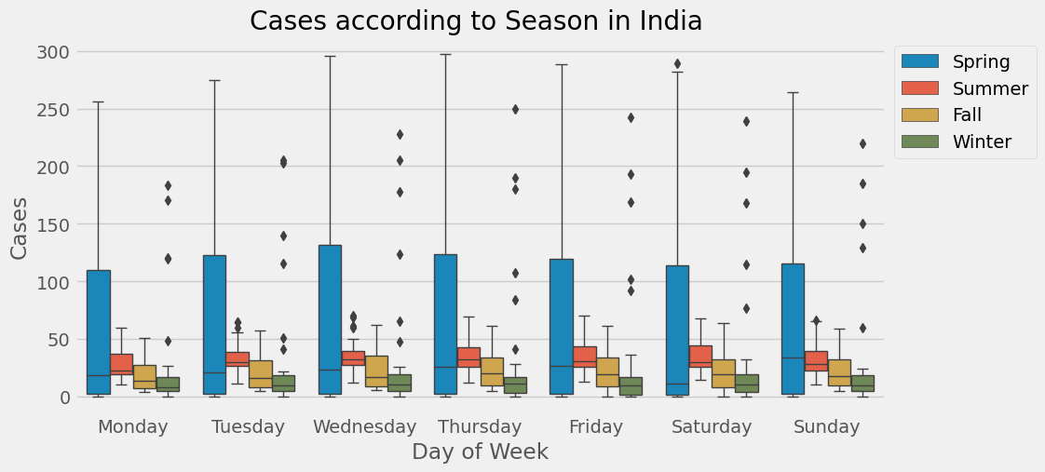

Slide 26
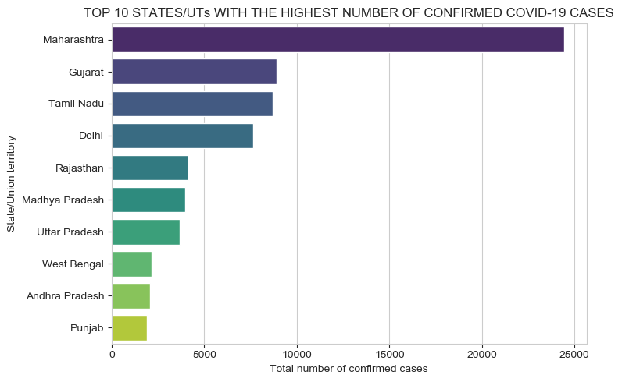

Slide 27
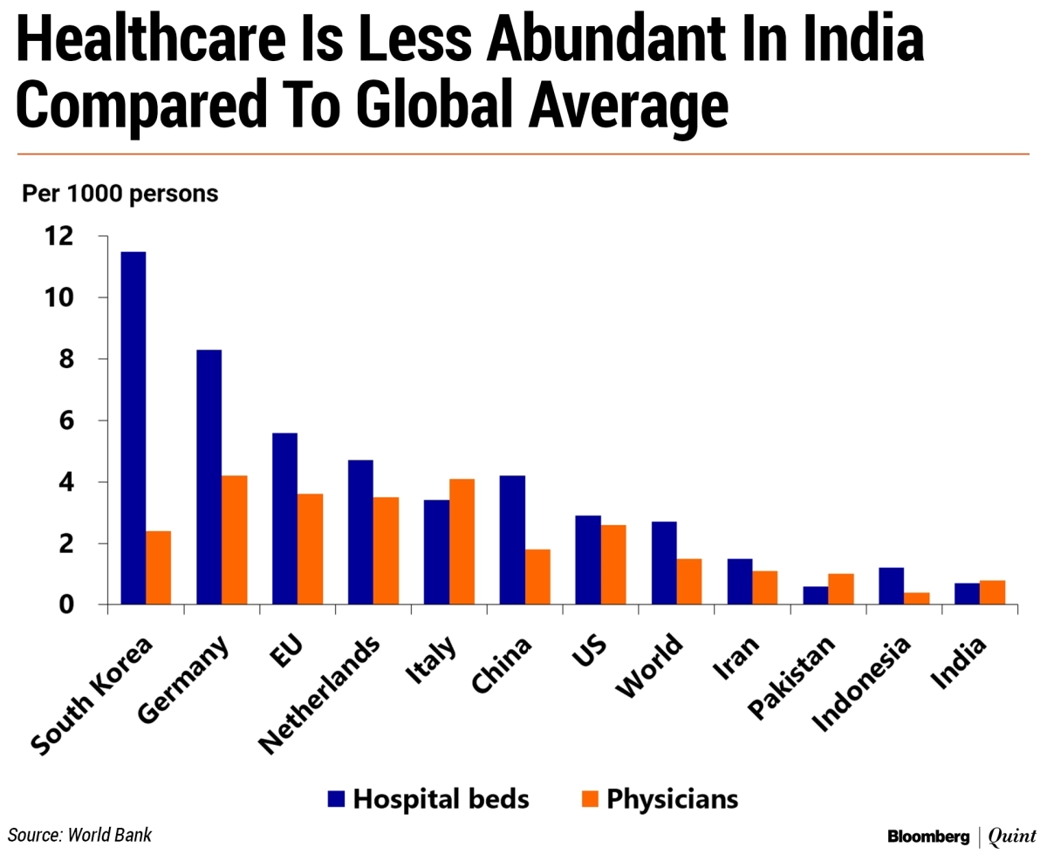

Slide 28
EXPLORATORY DATA ANALYSIS
X-Ray Image Detection

Slide 29
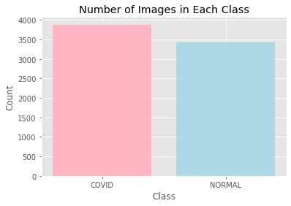

Slide 30
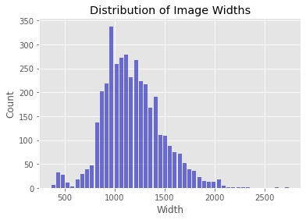
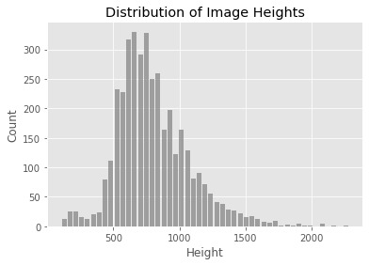
Height and Width Distribution of images

Slide 31
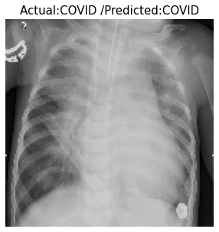
A pre-trained CNN model predicts the class of the image based on whether it belongs to the "NORMAL" or "COVID" category.
Expected Outcome

Slide 32
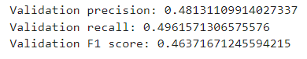
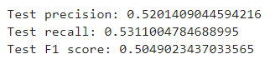
PRECISION and RECALL Scores for validation and test set.

Slide 33
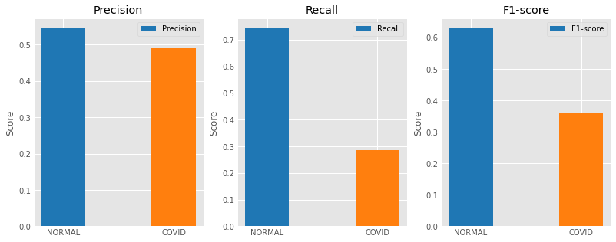
Random Forest Model
The precision, recall, and F1 score for the Normal class is higher as compared to the Covid class.
The precision score for covid class is higher than the recall and F1 scores.

Slide 34
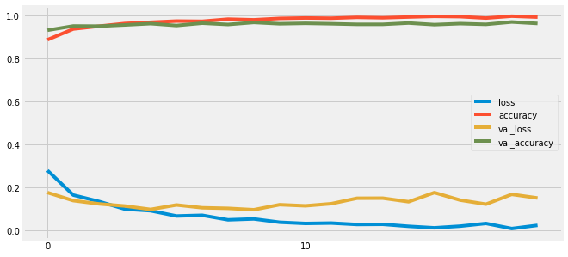
Line Graph Depicting Loss & Accuracy of CNN Model

Slide 35
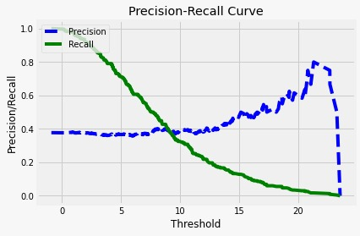

Slide 36
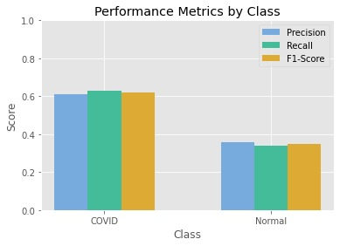
Precision, recall, and F1 score are higher for the "COVID" class than for the "Normal" class

Slide 37
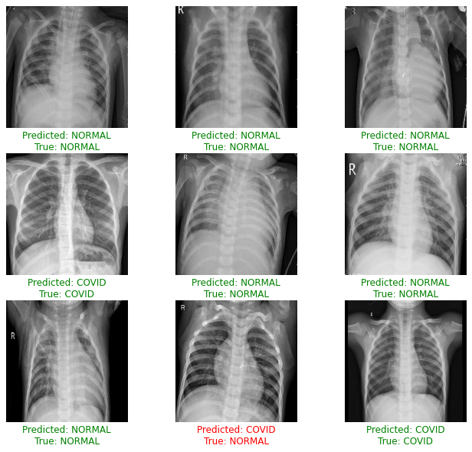
The predicted label is based on the predicted probability, whether it is greater than 0.5 or not.
If the predicted and true labels match, the text color is set to green, otherwise, it is set to red.
Prediction on Test Data

Slide 38
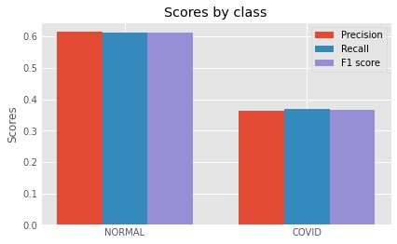

Slide 39
CONCLUSION

Slide 40


Slide 41
FUTURE SCOPE
Enhance the current models to improve the accuracy.
R&D on the advance models
Generalization to other respiratory diseases

Slide 42
THANK YOU!
Questions are welcome, if any.

Slide 43
REFERENCES
www.kaggle.com
https://www.who.int/
Communicating with Data: The Art of Writing Data Science
Storytelling with Data : A Data Visualization Guide for Business Professionals
GitHub Repository
Hands on Machine Learning by O'Reilly

